Slide 1
Lucky – Our little café

Slide 2
The requirements of the product owner
The product owner wanted a modern, aesthetic and responsive page.

Slide 3
The requirements of the product owner
During the making of the web page we kept in contact with the product owner, who, after seeing the wireframe and the prototype, approved the designs put forward by us, which we kept in mind during the process.

Slide 4
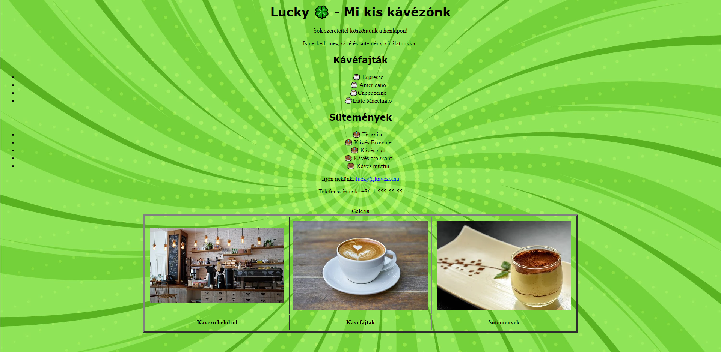
The old website

Slide 5
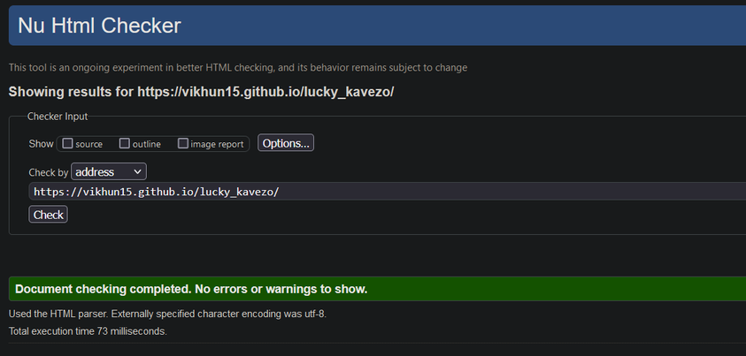
Validation - HTML
The goal of the HTML validation is the examination of the web page architecture, whether if it complies with the standards put forward by the W3 Consortium.
The HTML validation was successful.

Slide 6
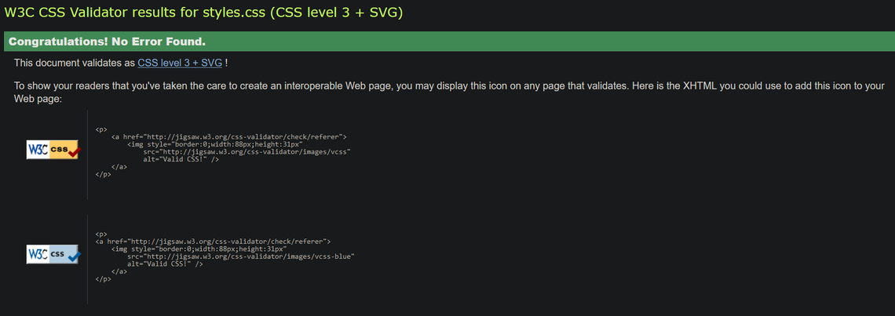
Validation - CSS
The goal of the CSS validation is the examination of the web page stylesheets, whether if they comply with the standards put forward by the W3 Consortium.
The CSS validation was successful.

Slide 7
The team structure
Name | Role
Bendegúz Városi | Project Manager
Viktor Ákos Ónodi-Kiss | Web developer
Ákos Koncz | Business Analyst
Károly Ádám Hézső | UI designer

Slide 8
Introducing the team: Tasks
Bendegúz Városi
Viktor Ákos Ónodi-Kiss
Main page
Modal
Trello
Git Repo management
Client side programming
Validation
Blog

Slide 9
Introducing the team: Tasks
Ákos Koncz
Károly Ádám Hézső
Desserts page coding
Modal
Communication with the product owner
Collecting graphical elements
Coffee types page coding

Slide 10
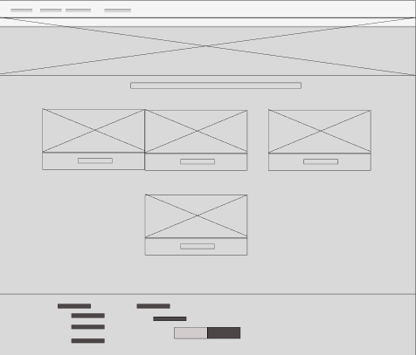
Planning: The wireframe
The wireframe contains the architecture of the page
The structure of the web page was built up using the design of the wireframe, by which point we take the possibilities provided by Bootstrap into account.
The wireframe was approved by the product owner.

Slide 11
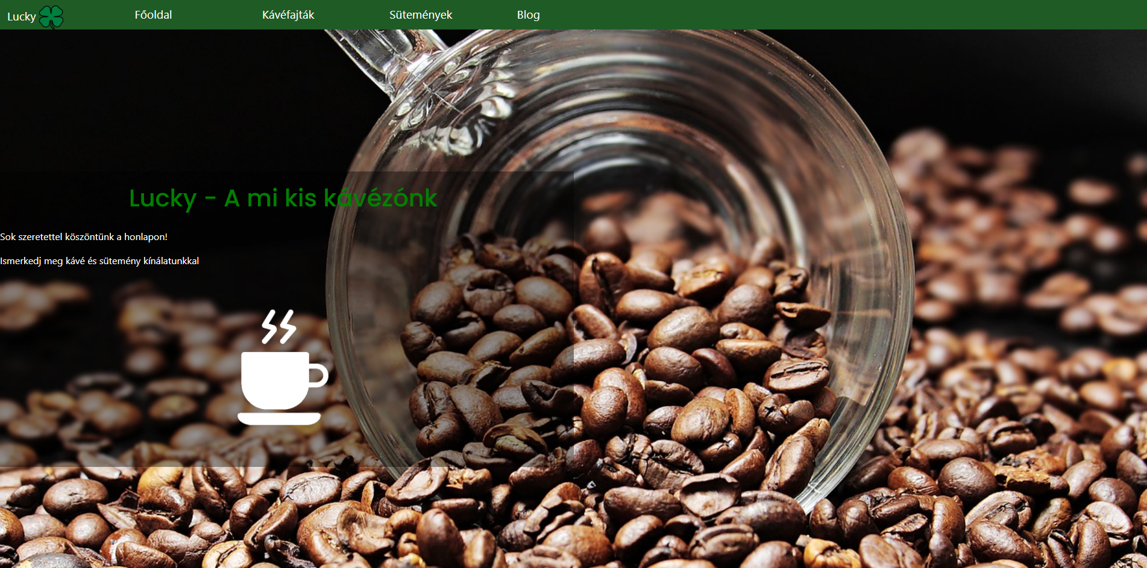
Planning: Prototype – Main page
During the making of the prototypes, we made the navbar found in the header and the contacts found in the footer into a template.

Slide 12
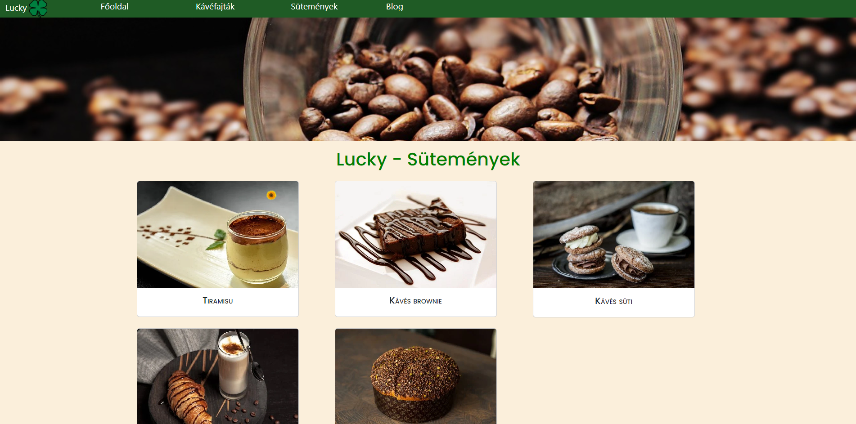
Planning: Prototype – Desserts page
The desserts page contains a model and every day a new daily choice appears, marked by a sunflower.

Slide 13
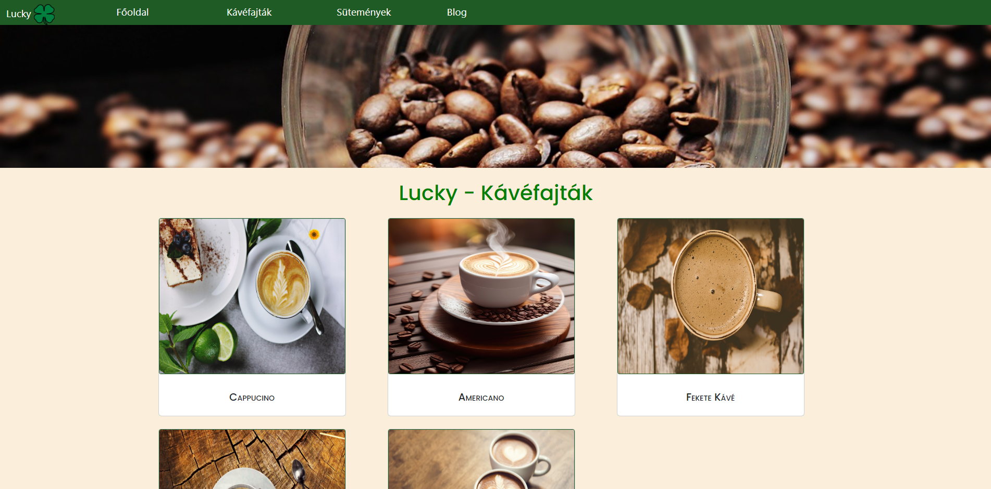
Planning: Prototype – Coffee page
The coffee page is almost entirely similar to the desserts page.

Slide 14
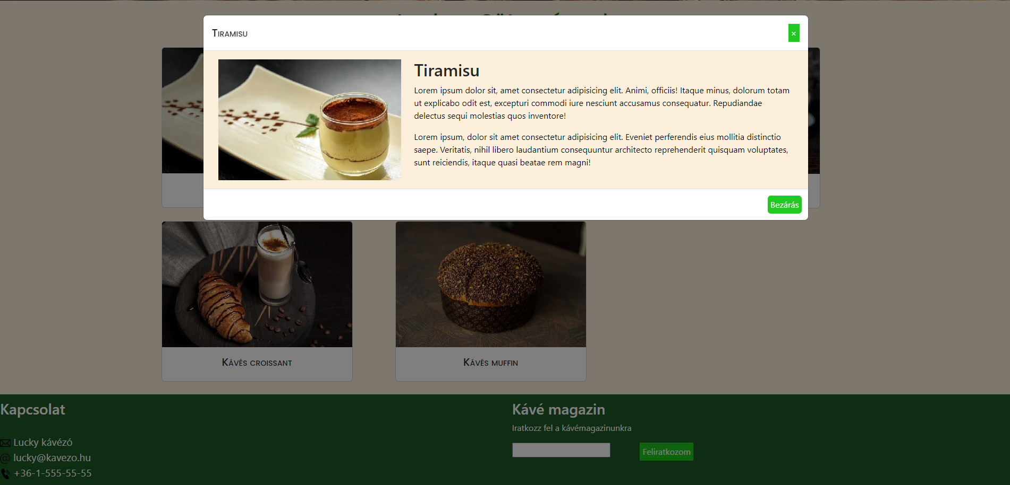
Planning: Prototype – Coffee page
The coffee page is almost entirely similar to the desserts page.

Slide 15
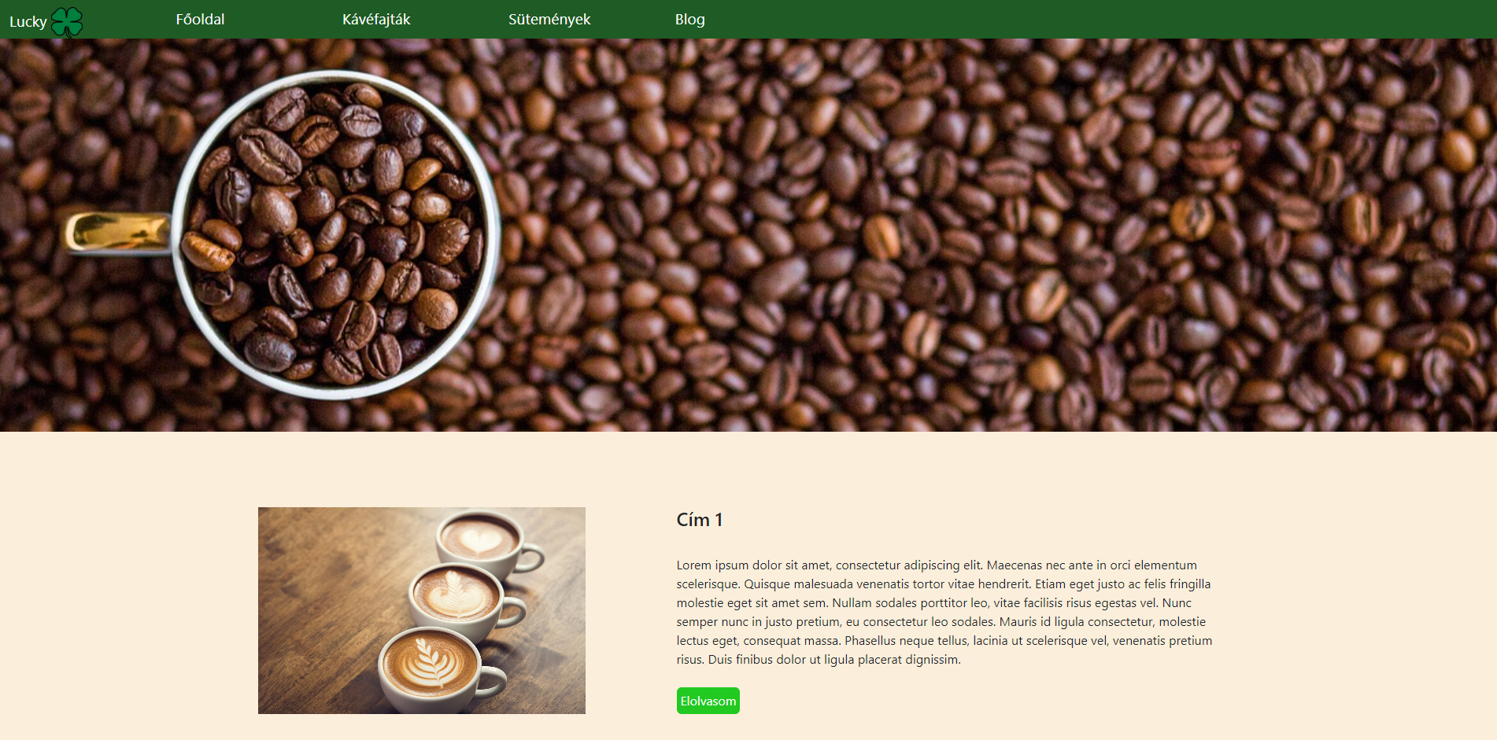
Planning: Prototype – Blog page
The blog page contains the articles that can be clicked, at which point a new page appears with the entire article.

Slide 16
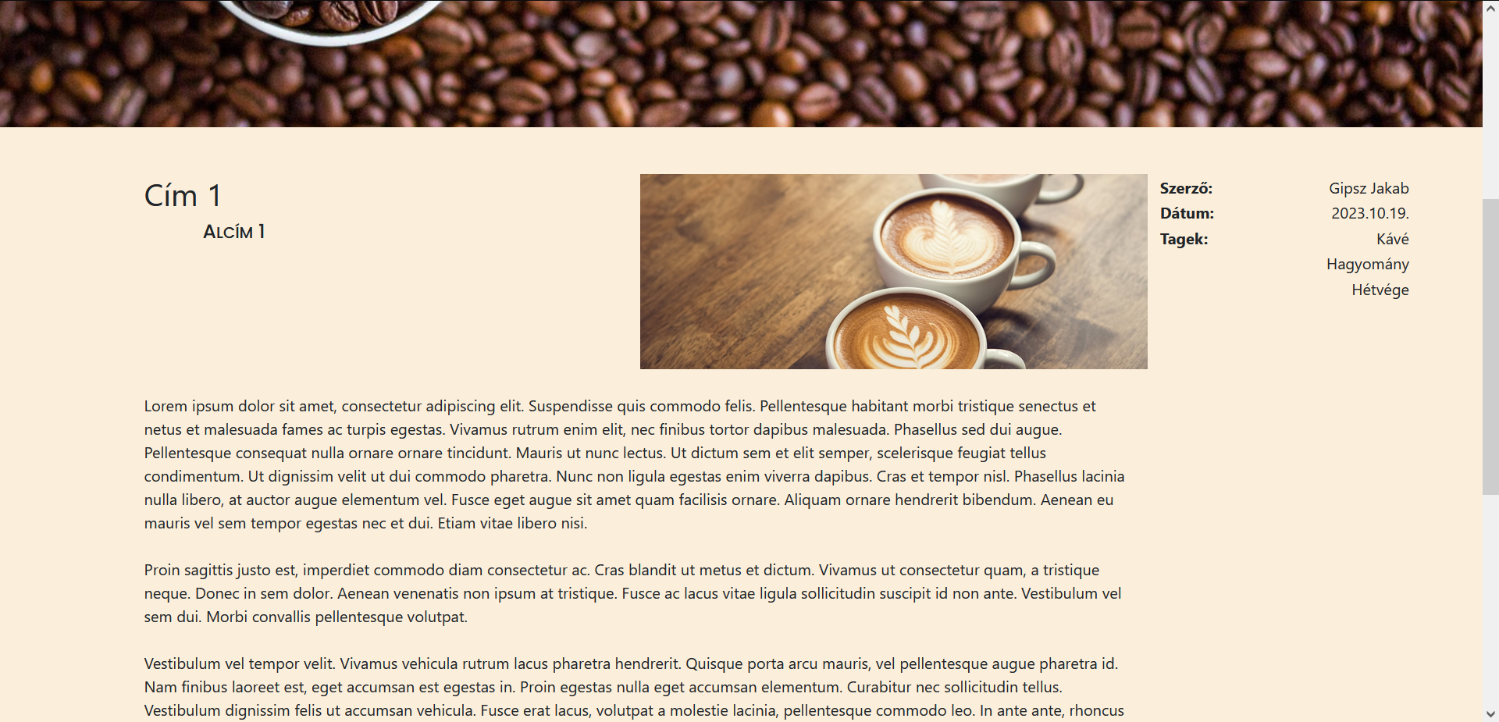
Planning: Prototype – Blog page
The blog page contains the articles that can be clicked, at which point a new page appears with the entire article.

Slide 17
Used tools/technologies
Web page planning:
Trello
Figma
Web page creation:
HTML
CSS
Javascript
Visual Studio Code
GitHub
Bootstrap

Slide 18
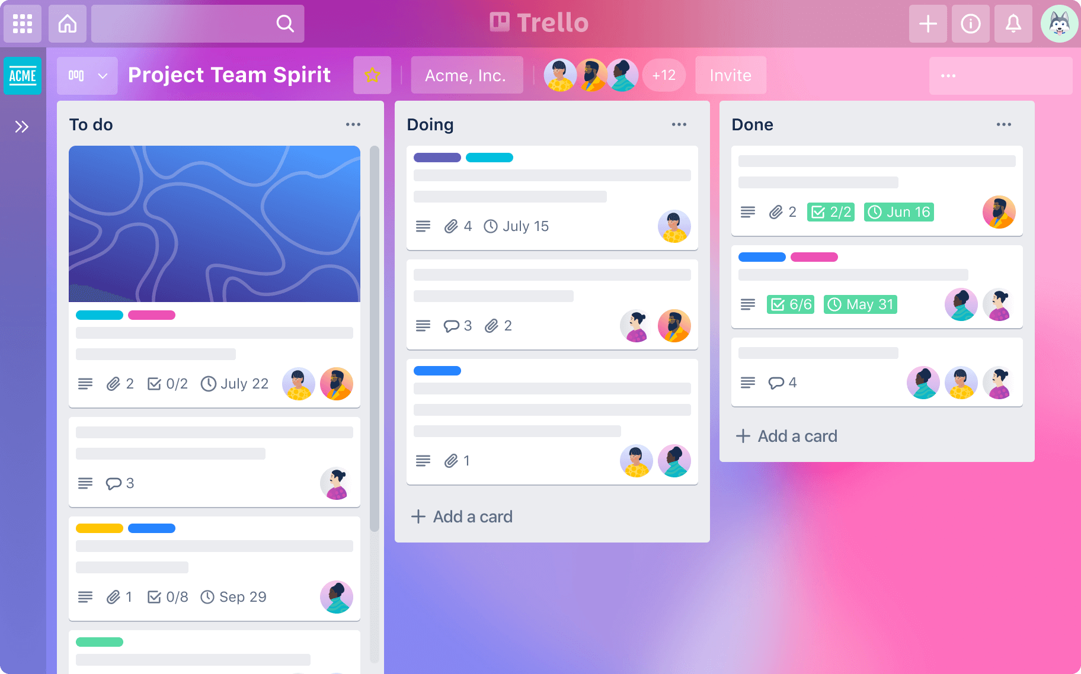
Trello
Using Trello we could follow the project development with cards and lists.

Slide 19
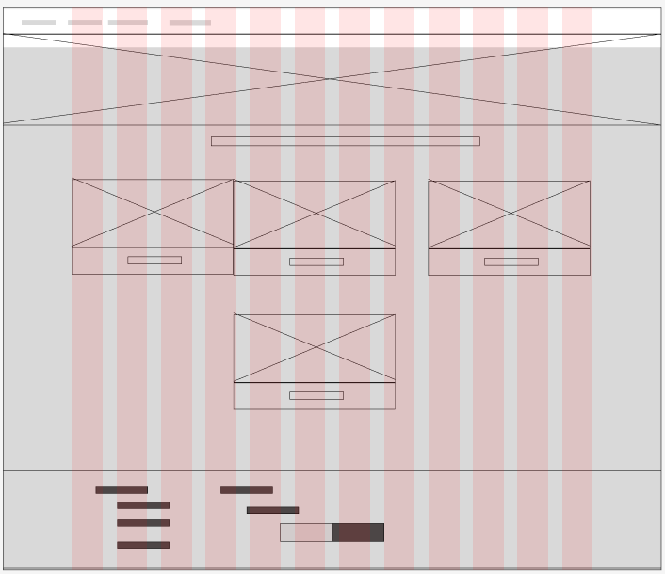
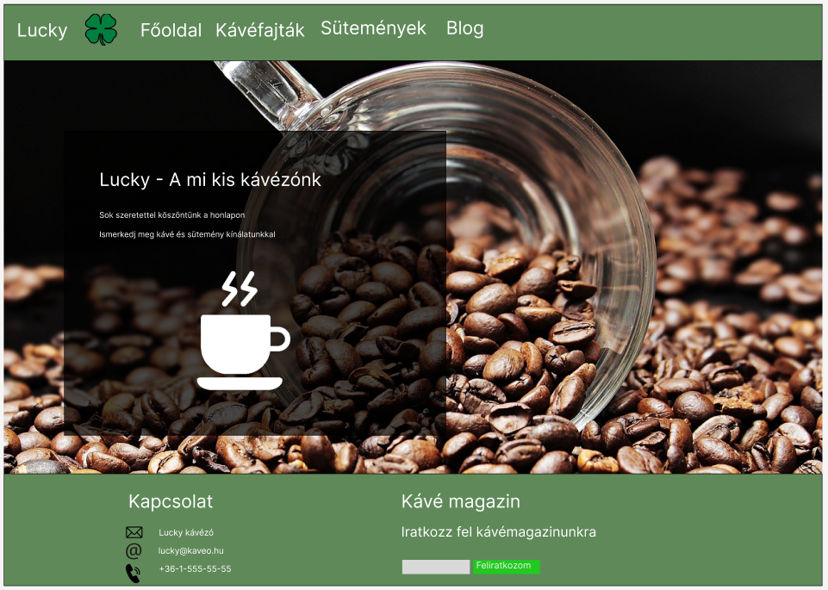
Figma
Using Figma , we created the prototype and the wireframe

Slide 20

HTML
During the maeking of the page we used HTML5 (HyperText Markup Language), which allowed us to change/modify the DOM (Document Object Model).

Slide 21

CSS
Using CSS (Cascading StyleSheets) we could apply certain styles to out web page.
During the making of the web page, we used the CSS3 version.

Slide 22

JavaScript
Using the JavaScript we could manipulate the DOM to change when certain events happen.
We used this mainly aat the making of the footer.

Slide 23

Visual Studio Code
Visual Studio Code (often called VS Code) is a text editor, which proved to be of great use to use thanks to it’s built-in functions.

Slide 24

Bootstrap
Bootstrap is a front-end framework that extends the possibilities of vanilla CSS and HTML.
Using Bootstrap we could create the modal and create the styles for the pages.

Slide 25

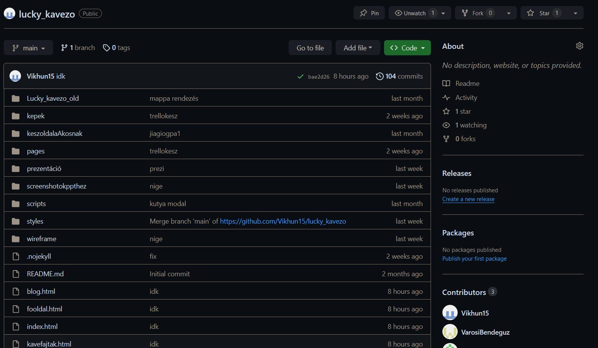
GitHub
GitHub is often used by programmers.
We used this version-management tool to coordinate out workloads and we also kept the entire project synced and stored there, in the cloud storage.

Slide 26
The link to the website

Slide 27
Thank you for your attention

